Slide 1
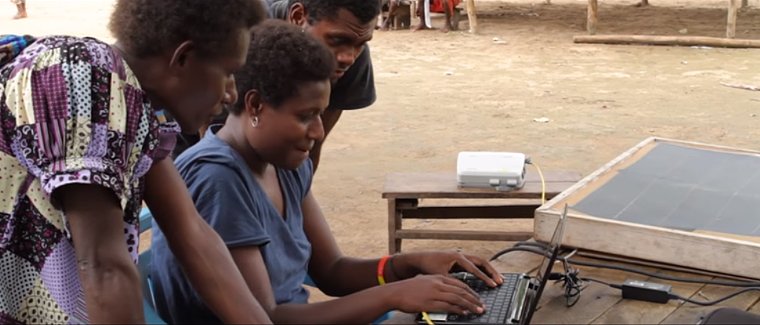
Meaning Based Bible Translation
Topic 2

Slide 2
Language Translation
1
2
Form based translation: accuracy of original language
Meaning based translation: understanding the concept
Example in Spanish:
“Me Ilamo Juan”
“I call myself John”
“My name is John”

Slide 3
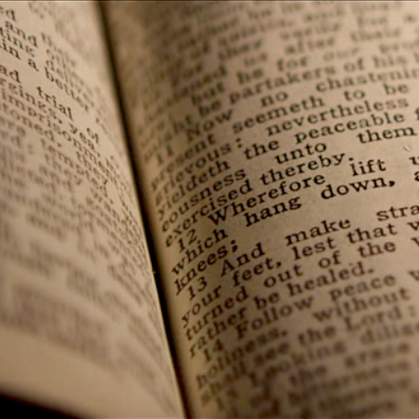
Translating Scripture
The MESSAGE is
SACRED
Changing & reordering words may be required

Slide 4


Another Example
“warm hearted”
The Lamogai language of Papua New Guinea
English:

Slide 5
Which method do you think is best for translating God’s Word?
Is there a way to be sure that the translation is understood by the community?

Slide 6


Coming Up:
8 Steps of the MAST method of Bible translation
Consistency
& Quality

Slide 7


